Slide 1
Reverse Engineering the "Waiting" Android Application
Sri krishna Nunna
Sai Kumar Gurram
Ayyala Akhil
Teja Peddi

Slide 2
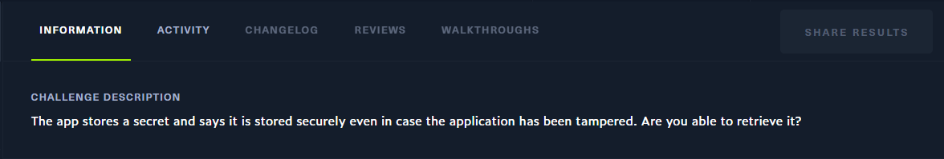
Introduction
We embarked on a thrilling project to dissect and uncover the concealed secrets within an Android application for our HTB challenge.
Our aim is to utilize reverse engineering techniques to unravel the app's mysteries and to retrieve the flag.

Slide 3
Opening in Android Studio
We started our project by installing the Android app development environment which in this case is Android Studio.
With keen attention to detail, we carefully examined the app's structure, resources, and dependencies.
By navigating through the project hierarchy, we gained valuable insights into the app's architecture and functionality.

Slide 4
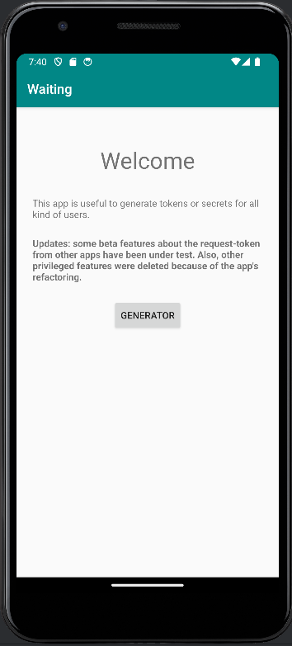
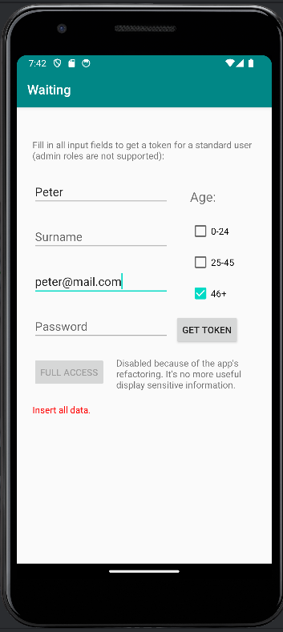
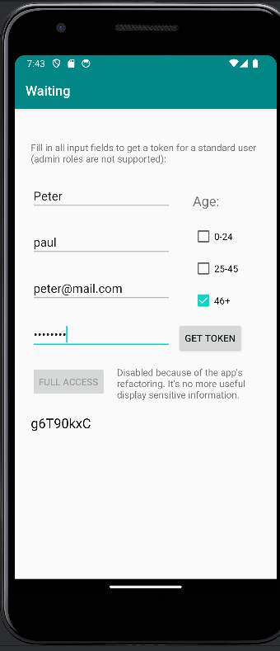
Opening App, Invalid & Complete Details

Slide 5
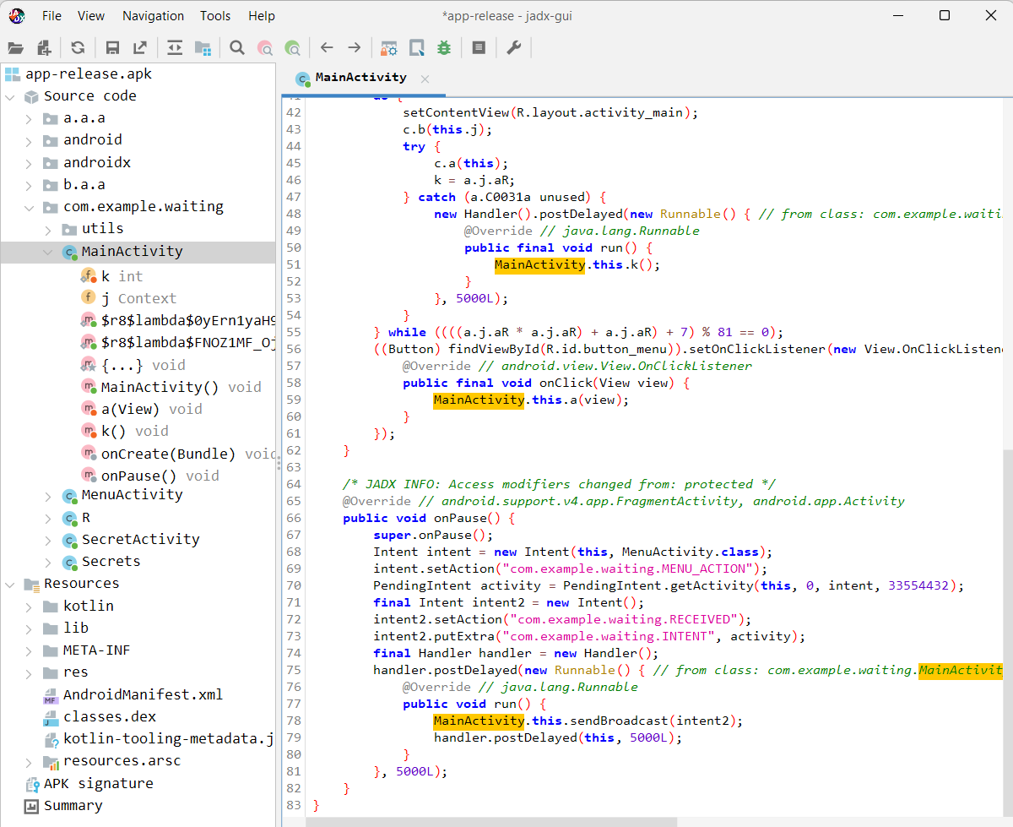
Decompiling with JADX
Armed with JADX, a powerful decompilation tool, we embarked on the next phase of our adventure.
With precision and finesse, we dissected the APK file, unveiling its inner workings and revealing the Java code beneath the surface.
Line by line, we scrutinized the decompiled code, hunting for clues and vulnerabilities that could lead us closer to our objective.

Slide 6
Modifying with APKTool
Equipped with the versatile APKTool, we wielded the power to decompile and modify the app's smali code with surgical precision.
With steady hands and keen eyes, we delved into the intricacies of the smali code, identifying areas ripe for modification.
Through careful analysis and experimentation, we strategically introduced vulnerabilities into the code, paving the way for future exploits.
With APKTool in our hands allowed us to manipulate the app's behavior, bringing us one step closer to unlocking its hidden secrets.

Slide 7
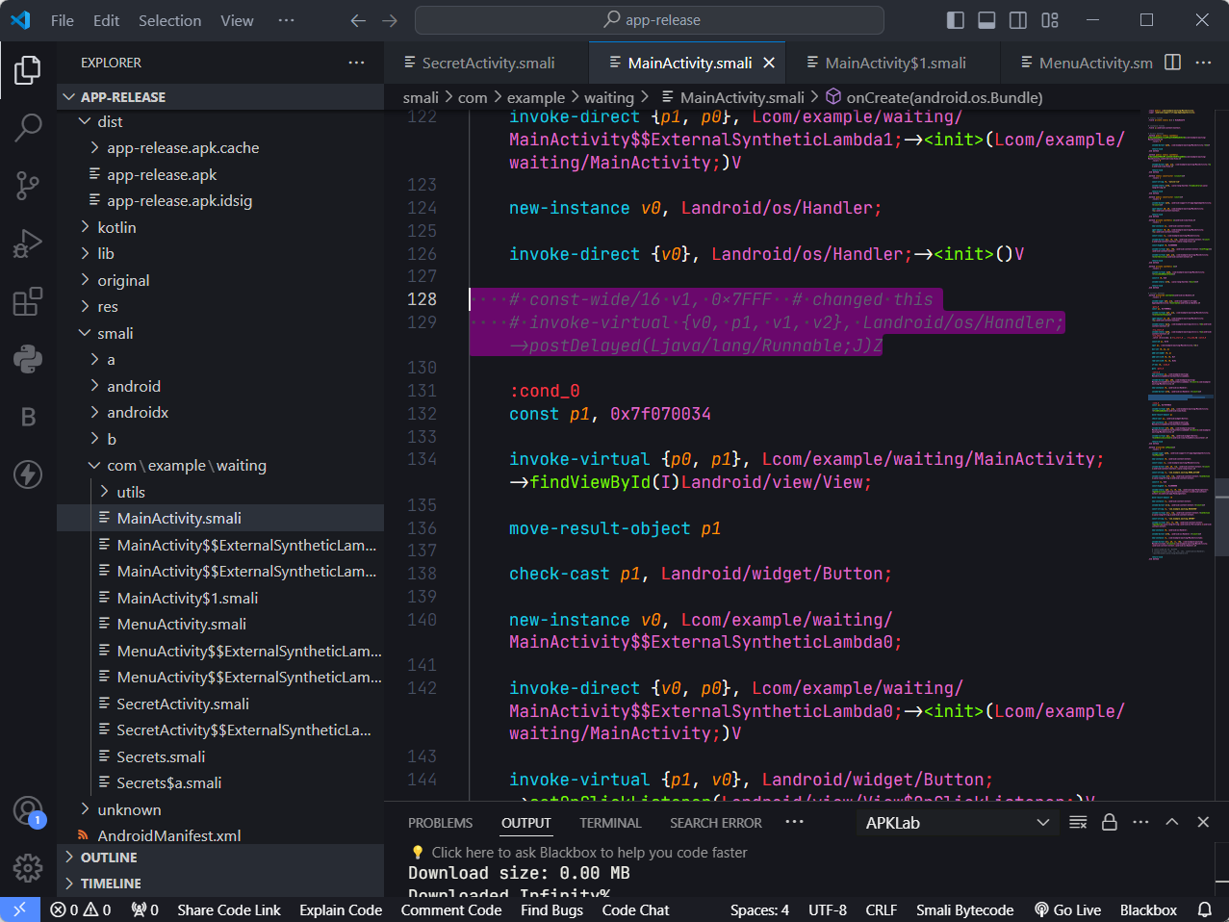
Decompiling Smali in VS Code
Transitioning to Visual Studio Code, we continued our exploration of the app's inner workings with renewed focus.
With precision and expertise, we analyzed and modified the identified Java code structures, tailoring them to suit our objectives.
The highlighted lines reflect on an attempt to remove app auto-close.

Slide 8
Enhancing with APKLab
We fortified our arsenal by integrating the APKLab extension, enhancing our capabilities for code analysis and modification.
With APKLab's suite of features at our disposal, we elevated our workflow with syntax highlighting, code navigation, and debugging tools.
Leveraging the power of APKLab, we optimized our code modifications, ensuring efficiency and precision in our endeavors.
Empowered by this indispensable tool, we forged ahead with confidence, ready to overcome any challenge that lay ahead.

Slide 9
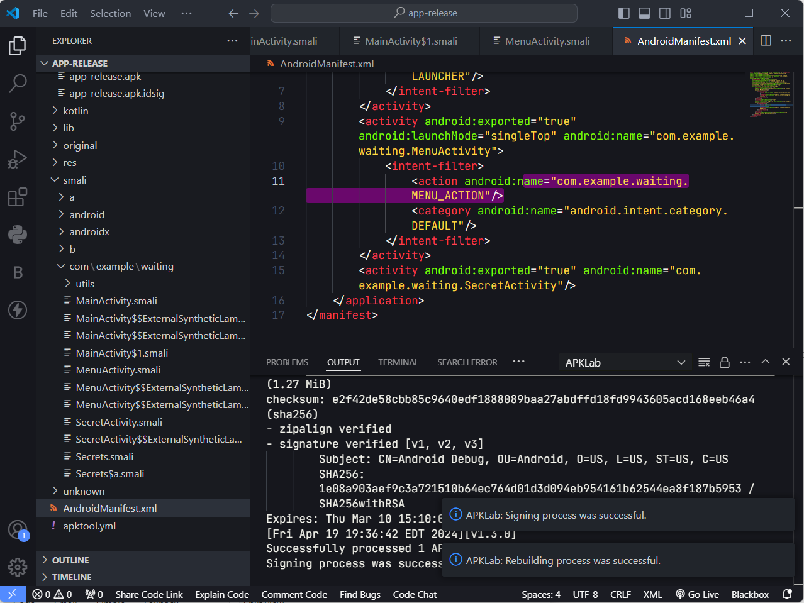
Rebuilding with APKTool
Armed with APKTool's prowess, we embarked on the journey of reconstructing the modified smali code into a functional APK.
Through the seamless execution of APKTool, we generated the modified APK file, poised for further testing and validation.

Slide 10
Loading in Android Studio
Returning to Android Studio, we eagerly loaded the modified APK file, ready to put our creation to the test.
With bated breath, we launched the app, eagerly anticipating the fruits of our labor to come to life on the screen.
Through rigorous testing and validation, we ensured the functionality and stability of the modified app, ironing out any lingering issues or discrepancies.
Our triumph in successfully loading and testing the modified app in Android Studio marked a significant milestone in our quest for the hidden secret.

Slide 11
Fixing Certificate Error
Confronted with the challenge of certificate errors, we tackled the issue head-on with determination and resolve.
Utilizing the keytool utility, we meticulously generated a new keystore, laying the groundwork for resolving the certificate error.
With unwavering precision, we signed the modified APK using jarsigner, ensuring the integrity and authenticity of our creation.
Our successful resolution of the certificate error underscored our adaptability and resourcefulness in overcoming obstacles on our path to victory.

Slide 12
Removing Delay Instances
In our relentless pursuit of perfection, we identified and addressed instances of delay within the app's activities.
With surgical precision, we removed or modified the delay instances in key components such as SecretActivity, MainActivity, and MenuActivity.
Through strategic intervention, we optimized the app's performance, minimizing unnecessary delays and enhancing user experience.
Our meticulous attention to detail in removing delay instances demonstrated our commitment to refining the app to its fullest potential.

Slide 13
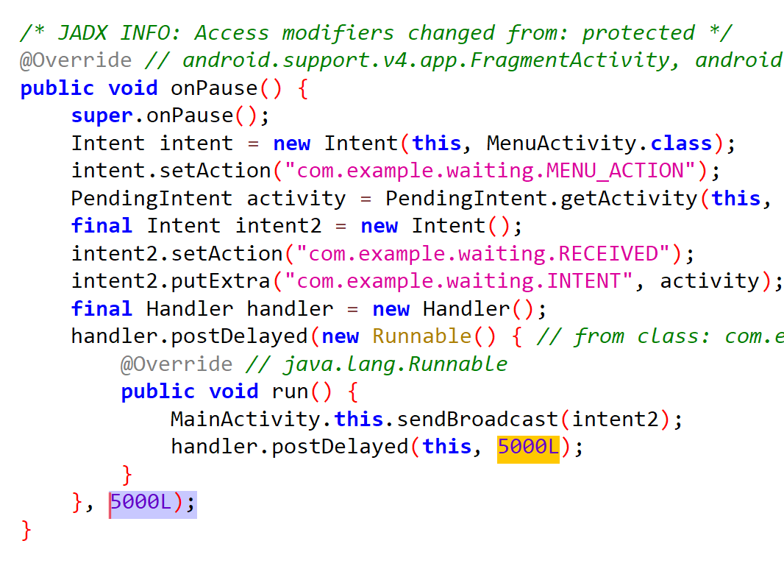
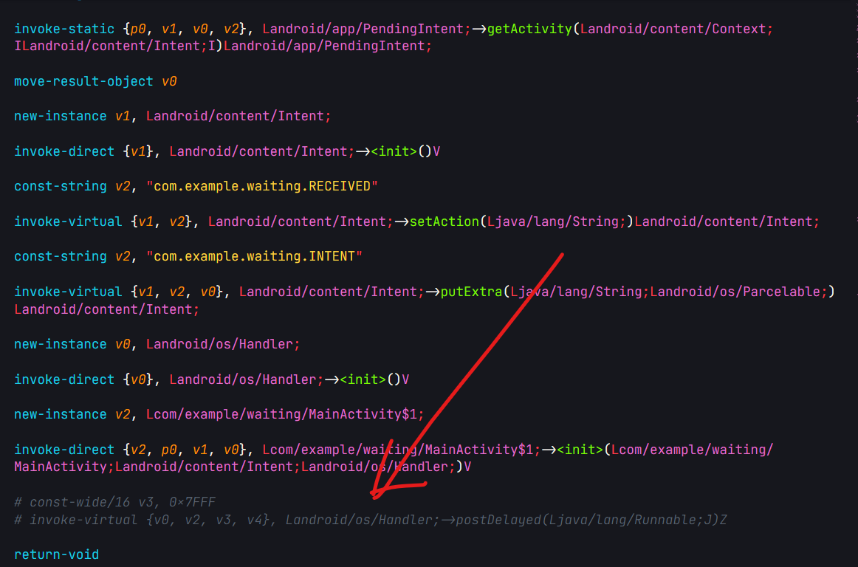
Removing Delay Instances (Example)
Java Code With Delays
Smali code, removed Delay Section

Slide 14
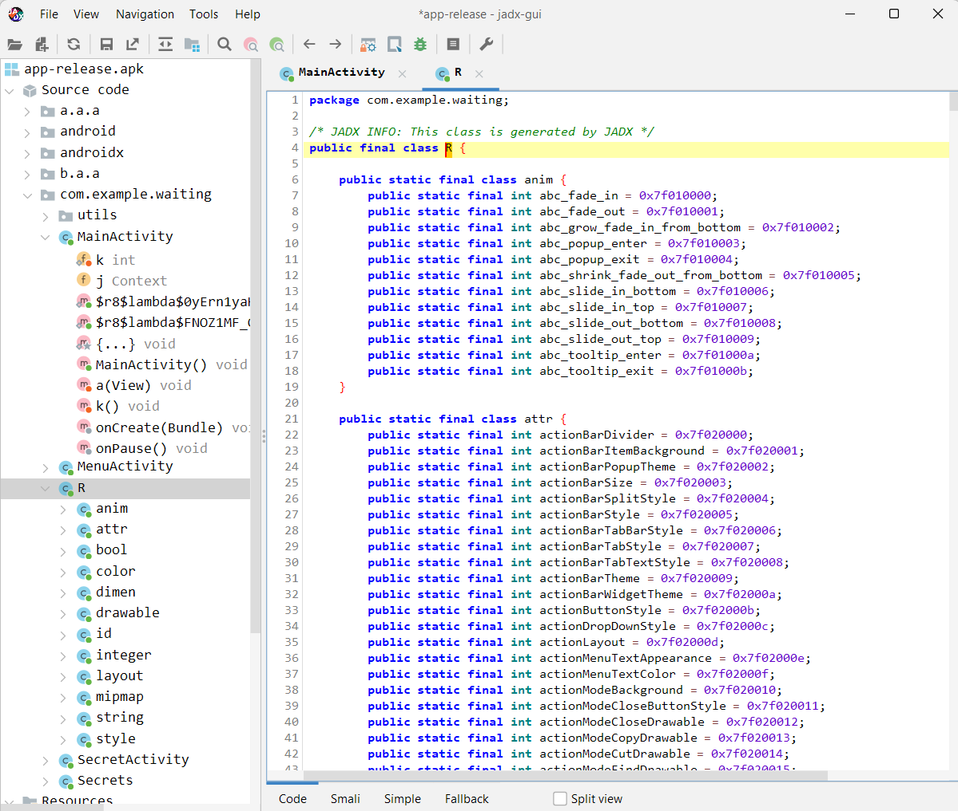
Investigating Activity IDs
Through meticulous analysis, we identified activity IDs associated with critical functionalities and user interactions.
Armed with this knowledge, we strategically modified activity IDs to align with our objectives, enhancing the app's usability and accessibility.

Slide 15
Debugging and Error Resolution
Equipped with a keen eye for detail and a relentless pursuit of perfection, we embarked on the task of debugging and error resolution.
Through rigorous testing and validation, we identified and addressed errors and inconsistencies within the app's codebase.
With unwavering determination, we meticulously resolved each error and discrepancy, ensuring the app's stability and reliability.

Slide 16
Further Decompilation & Code Analysis
Precise Code Scrutiny: Analyzed decompiled code line by line to identify vulnerabilities and hidden functionalities.
Strategic Code Modifications: Employed APKTool and Visual Studio Code for precise smali code modifications, utilizing extra help from AI models to aid in smali code interpretation
Cryptic Clues Exploration: Encountered cryptic codes and hints, triggering further investigation.
Challenge of Flag Retrieval: Despite meticulous analysis and modifications, the flag remained elusive.

Slide 17
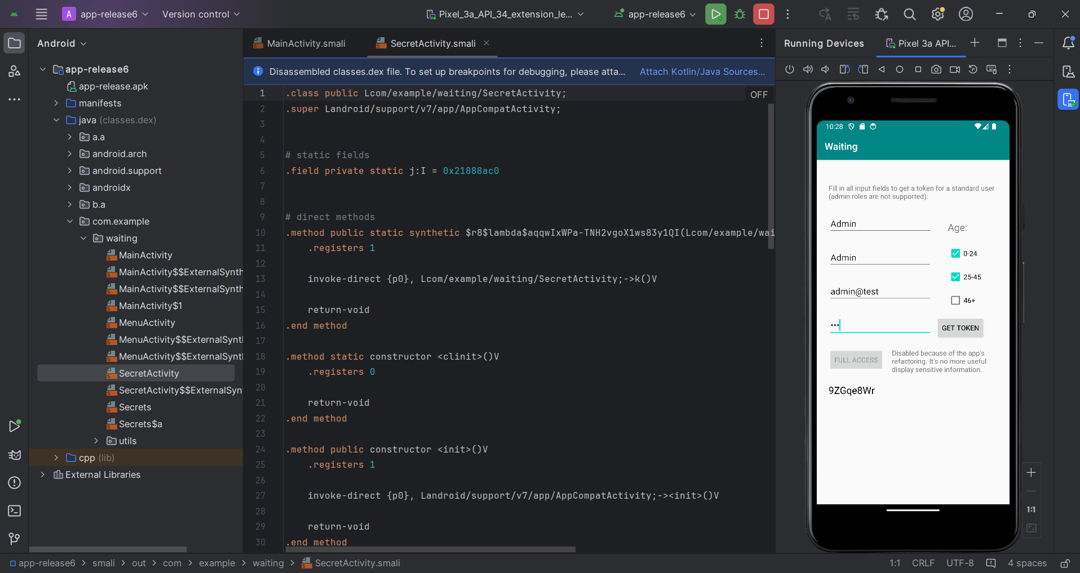

Slide 18
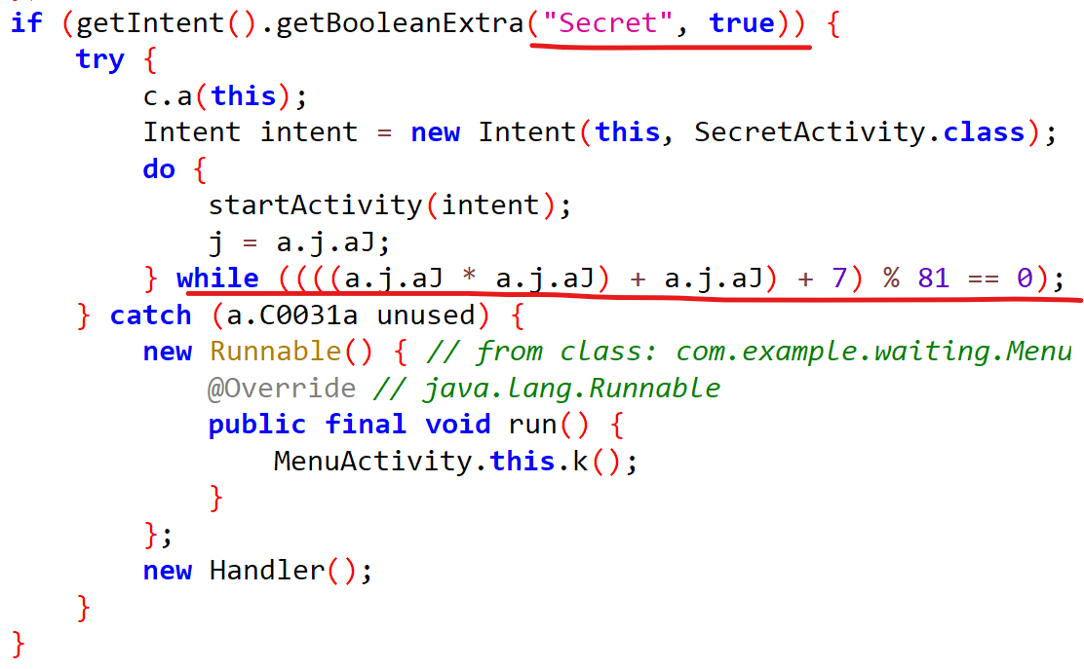
Vulnerability Discovery and Exploitation
Identified vulnerabilities within the app's security mechanisms through detailed code analysis.
Leveraged vulnerabilities to explore exploit scenarios and potential pathways for flag retrieval.
Utilized dynamic analysis and code injection to uncover runtime vulnerabilities and hidden functionalities.

Slide 19
Conclusion and Next Steps
Till now, we have decompiled and analyzed our Android Apk file by using Jadx-gui, by using reverse engineering technique we modified and rebuild the code using Apktool and successfully optimized the app’s performance by removing delay instances and also we exploited and discovered the vulnerability. But despite our efforts, we were not abled to retrieve the flag.
We remain committed to further exploit the file in order to find more vulnerabilities and to retrieve the flag and to conquer any other challenges.

Slide 20
The End

